Slide 1
Federal Tax Reform & Washington Tax: Opportunities & Considerations
What You Need to Know for 2018
Presented By:
Kurt Lippmann, Partner & Shane Griffiths, Senior Manager
Notes:
Kurt

Slide 2
250+ Aerospace Clients
Arizona
  Phoenix
California
  Fresno
  Los Angeles
    Manhattan Beach
  Napa
  Orange County
  Silicon Valley
  Sacramento
  San Diego
  San Francisco
  Santa Rosa
  Stockton
  Walnut Creek
    Woodland Hills
Kansas
  Kansas City
New Mexico
  Albuquerque
Oregon
  Eugene
  Medford
  Portland
Texas
  Dallas
Washington
  Bellingham
  Everett
    Issaquah
  Seattle
  Spokane
  Tacoma
    Tri-Cities
    Wenatchee
  Yakima
● | Moss Adams Location
● | Moss Adams Satellite
■ | --
■ | --
■ | --
30+
  locations west of the Mississippi
● | Moss Adams Location
● | Satellite

Slide 3
Tailwinds for Aerospace Industry
Tailwinds
Opportunities | Federal Tax Reform | Washington Tax
Tax Rates | Reduced tax rates | Preferential B&O tax rates
Tangible Property | Enhanced expensing rules | Property Tax B&O Credit
Product Development | Enhanced usability of research credit | Aerospace Development Credit
Foreign/Out-of-state Sales | Favorable taxation of foreign earnings | Interstate/foreign sales deduction
Tax Methods | More flexible tax methods for $25 million or less in revenues Retained LIFO for inventories | Follows Federal method
Notes:
The corporate rate drops to a 21% flat rate from the current graduated rates that top out at 35%.
Importantly, fiscal-year taxpayers will need to use a blended rate for the year that includes 1/1/18 based on the number of days before January 1st where the old rules apply and the number of days after January 1st where the 21% rate applies.
Additionally, the corporate AMT is repealed and there are reductions to the dividends received deduction due to overall rate decrease.

Slide 4
Tailwind: Federal Tax Rates C-Corporations
Business Provisions
Provision | Pre-Reform Law | Reform Act
Corporate Income Tax Rate | 35% top rate | 21% flat rate; effective 1/1/2018; blended rate for fiscal taxpayers
Corporate AMT | Applies | Repealed
Notes:
The corporate rate drops to a 21% flat rate from the current graduated rates that top out at 35%.
Importantly, fiscal-year taxpayers will need to use a blended rate for the year that includes 1/1/18 based on the number of days before January 1st where the old rules apply and the number of days after January 1st where the 21% rate applies.
Additionally, the corporate AMT is repealed and there are reductions to the dividends received deduction due to overall rate decrease.

Slide 5
Tailwind: Federal Tax Rates Flow-through Entities
Business Provisions
Provision | Pre-Reform Law | Reform Act
Highest Flow-through Income Tax Rate | 39.6% top rate | 37% top rate
20% Flow-through deduction (IRC 199A) | N/A | 29.6% equivalent tax rate
Individual AMT | Applies | Applies, but to fewer taxpayers
Notes:
The corporate rate drops to a 21% flat rate from the current graduated rates that top out at 35%.
Importantly, fiscal-year taxpayers will need to use a blended rate for the year that includes 1/1/18 based on the number of days before January 1st where the old rules apply and the number of days after January 1st where the 21% rate applies.
Additionally, the corporate AMT is repealed and there are reductions to the dividends received deduction due to overall rate decrease.

Slide 6
Tailwind: Federal 20% Flow-through Deduction
Parameters:
        New deduction equal to 20% of qualified business income
        For those with taxable income in excess of $415,000 (MFJ), the deduction is limited to the greater of:
          50% of W-2 wages or,
          Sum of 25% of W-2 wages plus 2.5% of the unadjusted basis of all qualified property
        Included businesses – most aerospace companies; engineering and design as well
        Excluded income – capital gains and losses, dividends, interest, and guaranteed payments

Slide 7
Tailwind: Federal Individual Income Brackets & Tax Rates
  Married Filing Jointly
15%
25 %
28 %
33 %
35 %
39.6 %
10%
12%
22 %
24 %
32 %
35 %
37 %
10%
Notes:
Still seven brackets
New top rate is 37% (versus 39.6%)
2018 rates sunset 12/31/25
(plus 0.9% Medicare tax on income >$200K/$250K)

Slide 8
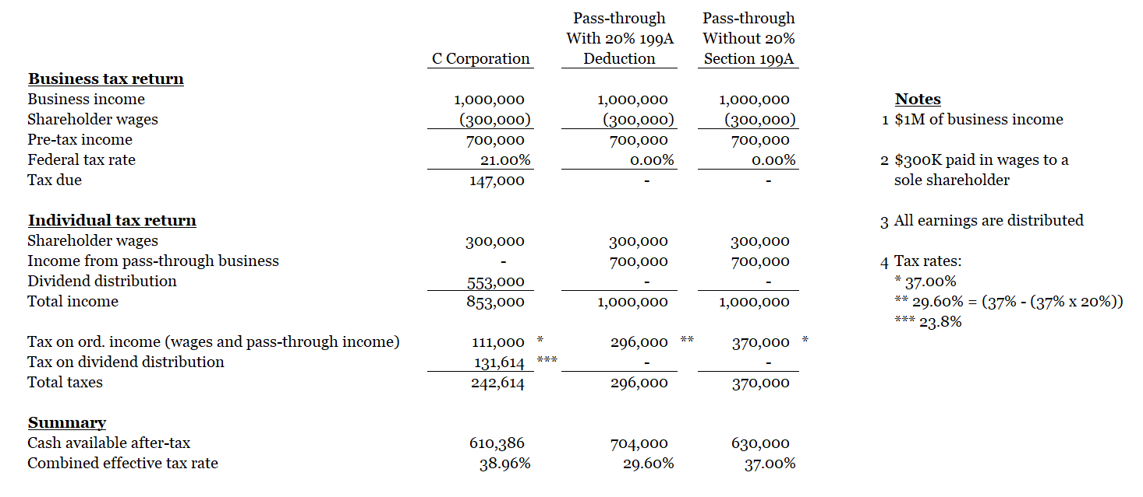
Tailwind: Which entity is best?
Pass-through vs. C Example – Cash After Tax

Slide 9
Considering Changing to a C Corp? Not So Fast!
Considerations
Timing of exit strategy
Multi-state income tax
Optimizing structure of international operations
Estate and gift tax
How will after-tax earnings be used?
What levels of income are you forecasting for the next five years?
How will accumulated earnings tax apply to your organization?
?

Slide 10
Tailwind: WA Preferential B&O Tax Rates
 |  | Sales Revenue | Reduced B&O Rate | Difference from Standard B&O Rate | Potential Savings
 | Manufacturers, Tooling Manufacturers, and FAR Part 145 Repair Stations | $10 million | 0.2904% | 0.1936% | $ 19,360
 | Nonmanufacturers | $10 million | 0.9% | 0.6% | $ 60,000
 | *Standard rates set to resume in 2040
DOR auditors are reviewing classification of revenue on a project-by-project basis.
Reviewing contracts/statements of work to confirm work relates an aerospace product.
For nonmanufacturers, there is an increased focus on determining the “deliverable” to confirm nonmanufacturer is not providing merely a “staffing service” or “project management” service.

Slide 11
Tailwind: Federal Cost Recovery Incentives
Provision | Pre-Reform Law | Reform Act
Bonus Depreciation | 50% bonus depreciation for qualified property acquired prior to 9/28/27; only for new property | 100% full expensing for qualified property acquired and PIS after 9/27/17 and before 1/1/23; new or used property; phase-down starts in 2023
Improvement Property | Four classifications – recovered over 15 years (QLHI, QRIP, QRP) or 39 years (QIP) – most eligible for bonus | Only QIP remains – drafting error results in 39 year recovery and no bonus
Section 179 Deduction | Expensing limits of $500K / phase-out starts at $2M | Expensing limits of $1M / phase-out starts at $2.5M; QIP now eligible

Slide 12
Tailwind: WA B&O Tax Credit for Property Tax
Personal property tax on machinery and equipment: B&O tax credit equal to the property or leasehold excise taxes paid on tangible personal property eligible for the manufacturing machinery and equipment (M&E) sales tax exemption.
Real property tax on land and buildings constructed used exclusively in manufacturing commercial airplanes or components.
    Caveat: Must be used exclusively in qualifying aerospace manufacturing or product development. This is strictly enforced.

Slide 13
Tailwind: WA Sales/Use Tax Exemption for Machinery/Equipment
Exemption: Manufactures are exempt from sales and use tax on machinery and equipment (“M&E”) used directly in a qualifying manufacturing or R&D operation.
Exempt ancillary costs: Includes labor and services in respect to installation, repair, cleaning, altering, or improving qualified M&E.
Primary use requirement: Must be used more than 50% of the time on an eligible activity.
Useful life requirement: Must have a useful life of one year or more.

Slide 14
Tailwind: WA Sales/Use Tax Exemption for Computer Hardware, Software, and Peripherals
Exemption: Retail sales and use tax does not apply on purchases of computers, software, and peripherals used primarily in the development, design, and engineering of aerospace products, or in providing aerospace services.
Exempt ancillary costs: The exemption also applies to charges made for labor and services rendered in respect to installation and set up.
Qualifying purchases:
          Computer hardware
          Software
          Peripherals (e.g., keyboards, monitors, mice)

Slide 15

Tailwind: Product Development Benefits (Federal R&D Credit)
Aerospace engineering, tooling, manufacturing, MRO, DER, PMA activities may qualify
Cash benefits can be up to 10% of qualified expenses
Qualified expenses may include labor, materials, and subcontractors
Credits can carryback one year and forward 20

Slide 16
Tailwind: WA B&O Tax Credit for Product Development Activities
Credit – B&O tax credit equal to the amount of qualified aerospace product development expenditures multiplied by 1.5%. Qualifying expenditures include wages, employee benefits, supplies.
Product development is defined as research, design, and engineering activities performed in relation to the development of an aerospace product or of a product line, model, or model derivative of an aerospace product, including prototype development, testing, and certification. It also includes “tool design and engineering design for the manufacturing process.”
Key – When does “production” begin?

Slide 17

Tailwind: Federal Tax Opportunities for Foreign Activity
C Corporations:
    Progress towards a territorial tax system – US companies only taxed on US earnings, with exceptions.
    Foreign activities deduction FDII
C Corporations & S Corporations:
    Retained foreign export incentive (DISC)

Slide 18
Tailwind: WA Interstate/Foreign Sales Deduction
Sales of tangible personal property – For Washington excise tax purposes, sales of tangible personal property are generally sourced to the location where the purchaser first either takes physical possession of, or has dominion or control over, tangible personal property.
Sale of services generally – Sourced to where the customer receives the “benefit of the service.”
Service related to tangible personal property – benefit is generally received where the tangible personal property is located or intended/expected to be located (not necessarily sourced based on where the work is performed).
DOR interim guidance – If R&D services related to specific product with an existing market, it may be reasonable to source to customer’s market. If R&D services do not relate to an existing product, then may be reasonable to source to location where R&D activity occurs.

Slide 19
Tailwind: Federal Accounting Methods
Provision | Pre-Reform Law | Reform Act
Simplified Methods for Smaller Taxpayers | Access to cash method and exemptions from inventory, UNICAP, and POC methods limited | Taxpayers with gross receipts of less than $25M can use cash method and are exempt from required inventory/UNICAP methods and POC for LTCs
Accrual Income Inclusion | Recognize when “fixed and determinable” – generally, earliest of when due, paid, or earned | Accrual taxpayers with AFS must recognize income no later than when recognized in AFS; AFS is Form 10-K, audited F/S, F/S provided to fed/state govt or agency (not a tax return)
Notes:
Peter

Slide 20
Tailwind: Tariffs and the use of LIFO for Federal Tax Purposes
15 of the 20 reviewed LIFO IPIC categories for A&D have increased year to date.
Despite speculation, tax reform did not repeal LIFO
Recent tariffs on imported aluminum and steel have contributed to increased cost of metals, including those purchased from domestic suppliers
Adapting LIFO could allow certain companies to increase their cost of goods sold deductions
Specifically applicable to machine shops and other component part manufacturers that rely heavily on raw metals inputs
Notes:
Peter

Slide 21
Headwinds for Aerospace Industry
Federal Tax Reform | Washington Tax
New interest expense limitations New loss limitations rules New corporate net operating loss rules Repeal of Domestic Manufacturing Deduction Complex rules for companies with international operations No like-kind exchanges except real property | Annual reporting requirements

Slide 22
Headwinds – WA Annual Reporting Requirements
Filing requirement: Must submit an annual performance report to the Department of Revenue detailing employment, wages, and employer-provided health and retirement benefits for employment positions in Washington
Due date: Due May 31 of each year for the prior year’s activities
Penalties: Significant penalties for late filing or not filing
          35% of the amount of tax incentives claimed for the previous calendar year
          Additional 15% of the amount of tax incentives claimed for the previous calendar year if the taxpayer has previously been assessed for a failure to submit reports

Slide 23

Tax Highlights Wrap Up
Understand how the Federal and Washington tax opportunities impact your organization.
Determine and implement your revised strategic plan.
Take advantage of the transition before year-end.

Slide 24

Questions?

